Slide 1

Introduction
This presentation critically analyzes a significant cyber-attack, focusing on identifying, assessing, and managing threats that disrupt operations, damage assets, or harm people.
CC5052 Risk Crisis and Security Management
Presented by Prabin Pradhan

Slide 2
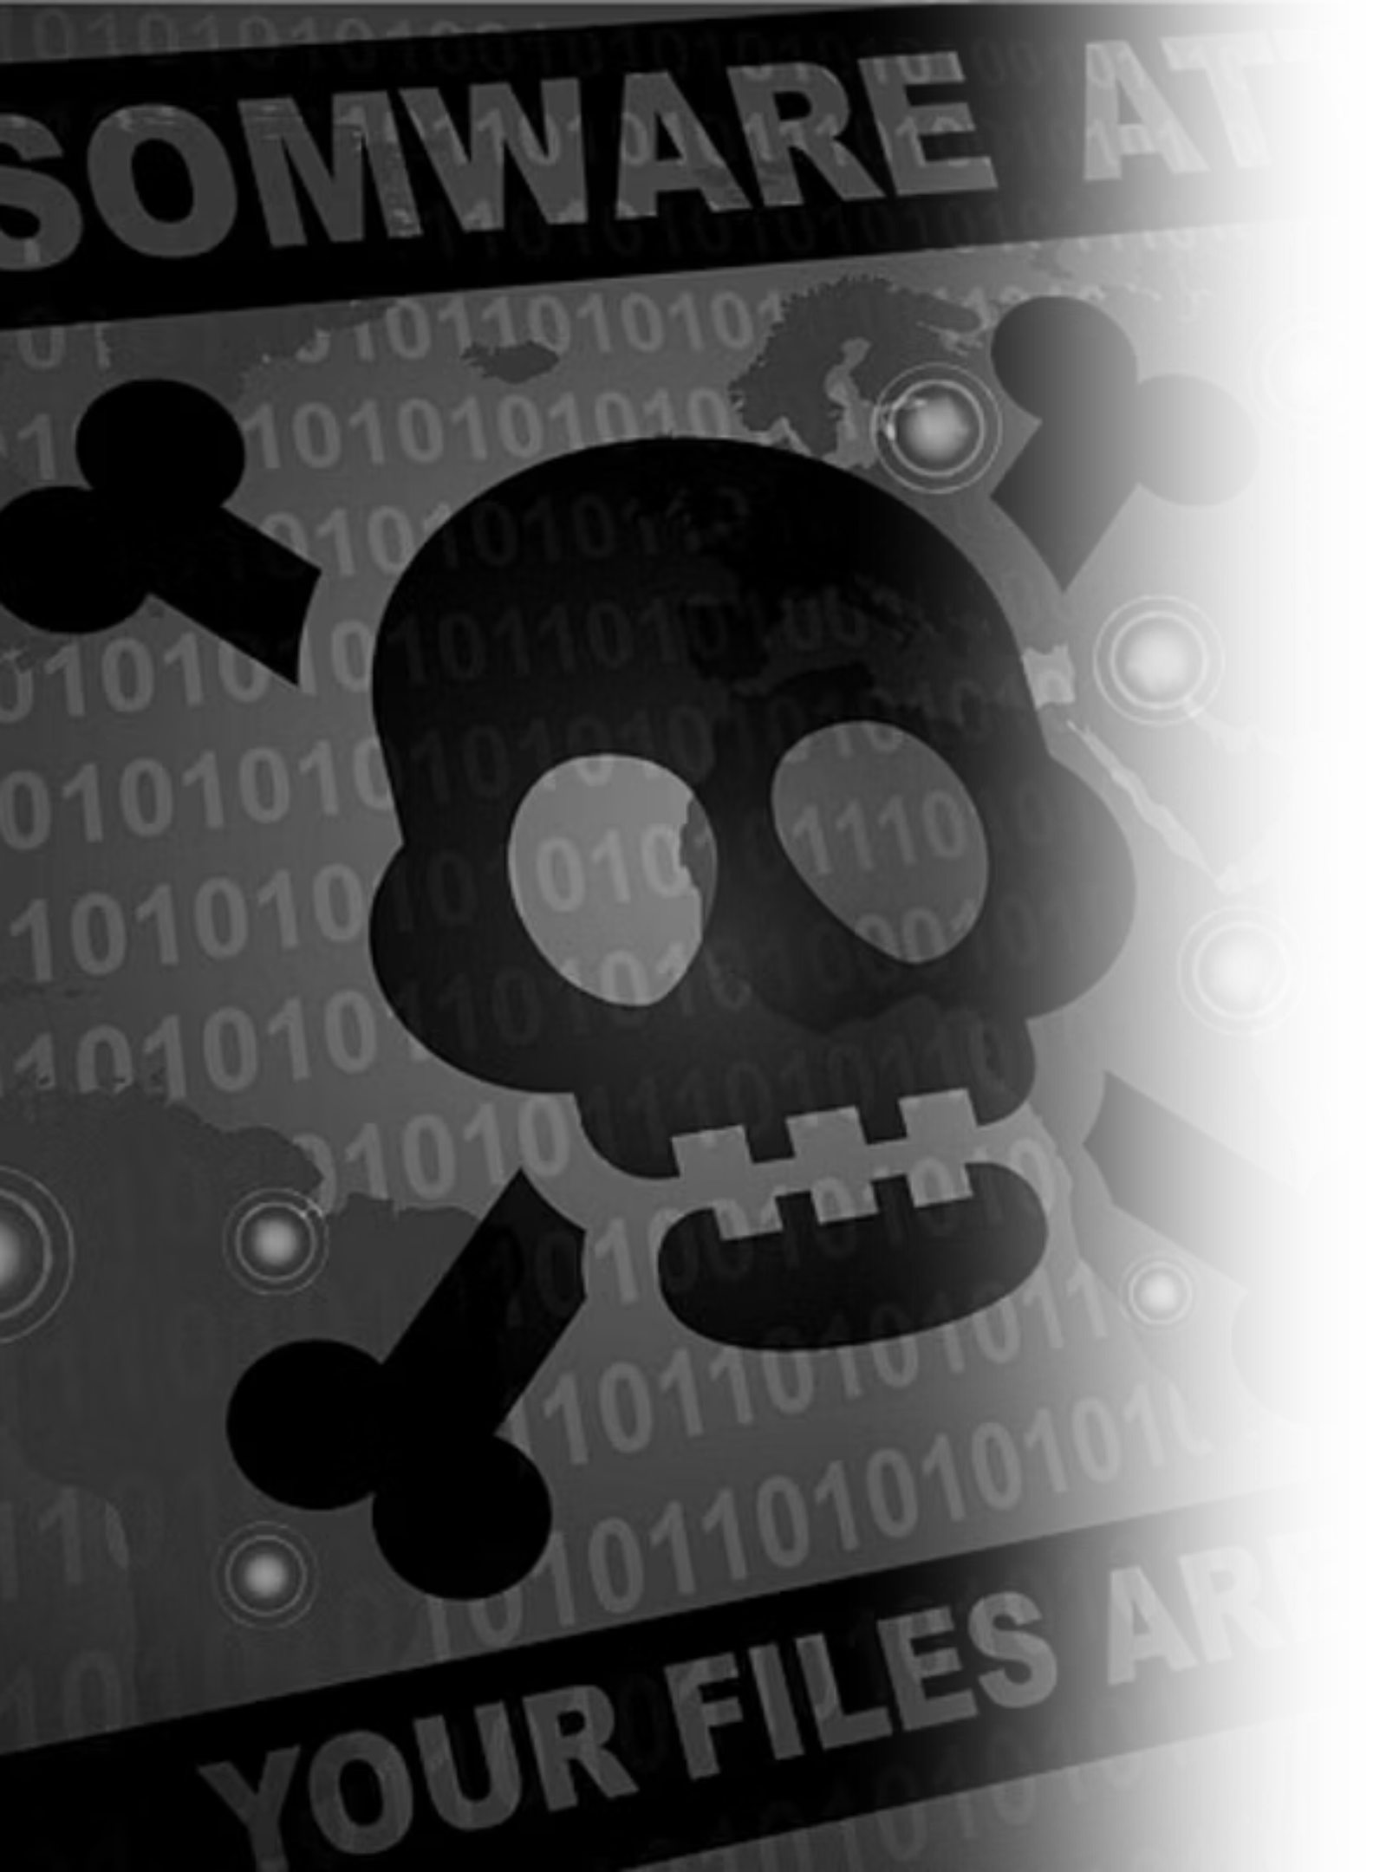
Understanding Ransomware: The Digital Hostage
Ransomware is a malware that encrypt or lock your important files and charge you a certain amount of money in exchange of restoring access. Ransomware attack has become a major security problem to governments and critical institutions worldwide.
One of the major example is Costa Rica Ransomware attack 2022.

Slide 3

Background Problem: Costa Rica Government
The Costa Rica Ransomware Crisis was sparked because of the long-existing vulnerabilities in cyber guidelines enforced in Costa Rica.
Many public bodies were heavily dependent on computer systems without implementing essential cybersecurity controls.
This result allowed the Conti Ransomware group, also known as Wizard Spider, to exploit these gaps.

Slide 4




Current Situation: International Assistance and Recovery
Global Support
Financial Commitment
Costa Rica received extensive technical assistance from nations such as the United States, Spain, Israel, and even Microsoft, to help restore systems.
The U.S. committed $25 million in funding to Costa Rica's broader ransomware recovery efforts.
Strategic Rebuilding
Enhanced Awareness & Cooperation
Costa Rica established a National Security Operations Centre and developed national playbooks and governance frameworks for cybersecurity response and risk reduction.
Costa Rica government boosted cybersecurity awareness, expanded incident response capabilities, and increased international cooperation to prevent future attacks.

Slide 5
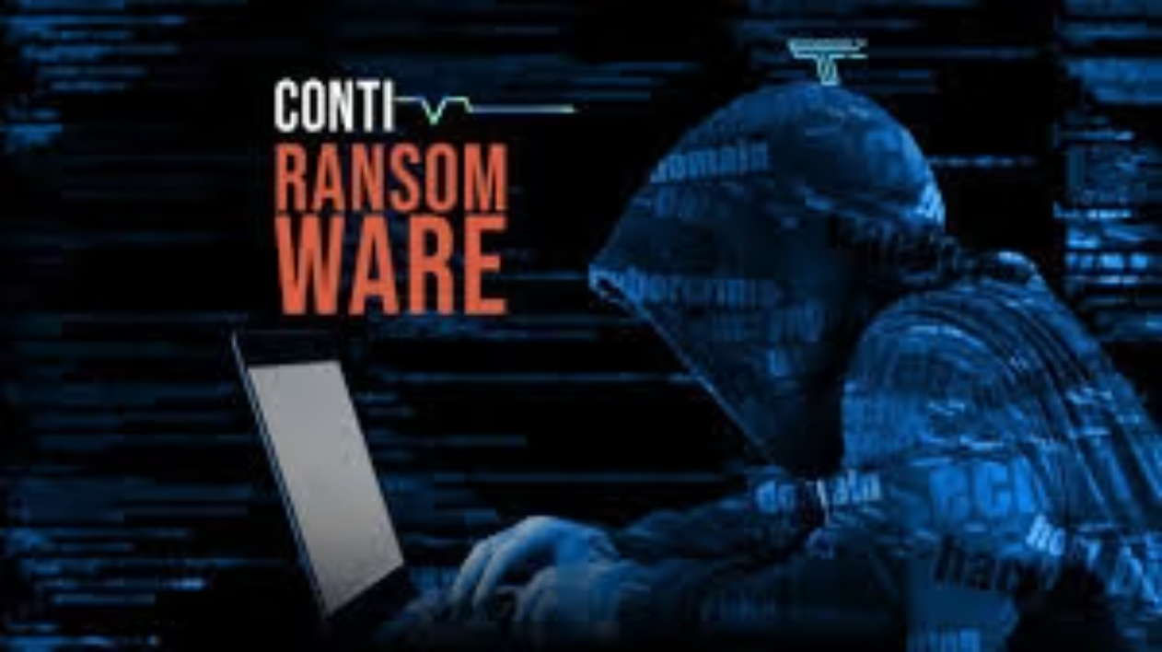

Conti Group: A History and Origin
Conti is a famous ransomware group responsible for numerous well-publicized attacks, believed to be an evolution of the Ryuk ransomware.
Conti operates on a "Ransomware as a Service" (RaaS) model, primarily targeting large organizations.
It is thought to be a evolve from the Ryuk ransomware, and it was probably developed by the same people who created Ryuk.
The group is well-known for employing double extortion tactics, in which sensitive information is stolen and victim files are encrypted.
The group is widely believed to operate from within Russia, executing its activities from this primary base.

Slide 6
Type of Ransomware used in Costa Rica Attack:
April 17, 2022
1
The initial wave of attacks on multiple government of Costa Rica agencies was executed by the Conti ransomware, also known as Wizard Spider.
2
April 17, 2022
Ministry of Finance Tax and Customs server (running Microsoft software compromised).
May 31, 2022
3
A second wave of ransomware attacks was launched, this time utilizing the HIVE ransomware, further crippling national infrastructure.
4
May 31, 2022
Hive ransomware possibly affiliated with Conti attacked 30 CCSS servers stealing healthcare data, asking for a $5M payment.

Slide 7

What Type of Ransomware is: Conti & HIVE
Conti Ransomware
HIVE Ransomware
A "Ransomware as a Service" (RaaS) model.
Also a "Ransomware as a Service" (RaaS) variant.
Human-operated, primarily targeting large enterprises.
Encrypts files on victim's servers, holding them for ransom.
Evolved from the Ryuk ransomware.
Similar to Conti in its use of double extortion tactics.
Known for aggressive tactics and double extortion, targeting sensitive data and healthcare organizations.
Also believed to be derived from the Ryuk ransomware lineage.

Slide 8
Attack Tactics: TTPs Employed by Conti
Initial Access
T1566.001 - Phishing
Conti gang send phishing email that seems legitimate, often impersonating trusted government department.
Credential Access
T1003 - Extracting Credentials
Credential dumping malware was used to extract stored credentials, including usernames and passwords, from compromised systems.
Lateral Movement
T1105 - Ingress Tool Transfer
The Conti gang transferred and deployed tools, such as Remote Access Trojans (RATs), into compromised Costa Rican government systems.
Command and Control
T1071.001 - Web Protocols
Conti gang used installed cobalt strike beacon to communicate and controlled server using HTTP/HTTPS traffic.
Impact
T1486 - Data Encryption
Conti gang encrypted system and all sensitive data of government agencies like Ministry of Finance and Ministry of Labour.

Slide 9

Background and Issue Identification:
The specific issue in the Costa Rica ransomware attack was the targeting of critical government infrastructure, particularly the Ministry of Finance, which disrupted digital tax and customs system.
The exposed of various weaknesses like no regulation forcing public institutions to implement recommended security controls, system updates or network segmentation and known vulnerabilities some of which existing for years remained unpatched in the country's cybersecurity refences
Public institutions lacked of sufficient trained cybersecurity professional and did not educate about phishing and malware risk.
This made social engineering attacks a likely entry points for ransomware, allowing malware spread internally.

Slide 10



Propose Mitigation Strategies:
The Mitigation Strategies of Conti Ransomware and HIVE Ransomware are based in risk management principles including identification, assessment and control.
Identify Risks
Assess Risks
Map critical assets, identify vulnerabilities, and understand potential ransomware threats.
Evaluate the likelihood of an attack and its potential operational, data, and financial impact.
Preventive Controls
Detective Controls
Implement patching, email filtering, network segmentation, MFA, and hiring Cybersecurity Exports
Utilize continuous monitoring, IPS/IDS, and audit logs for early detection and incident prevention.
Recovery Controls
Management Controls
Maintain backups, isolate infected systems, and follow a incident response plan.
Conduct regular risk assessments, update policies, and ensure controls remain effective against evolving threats.

Slide 11
End.

